Slide 1
Slide Title
Team Name: Xcess Denied 2. GitHub repository link: https://github.com/steveoscar12/Big-Data-with-Apache-Spark.git

Slide 2

Slide Title: SINDy Algorithm with Apache Spark Objective:
Implementing the SINDy (Sparse Identification of Nonlinear Dynamics) algorithm.
Technology: Utilizing Apache Spark for finding INDs.

Slide 3
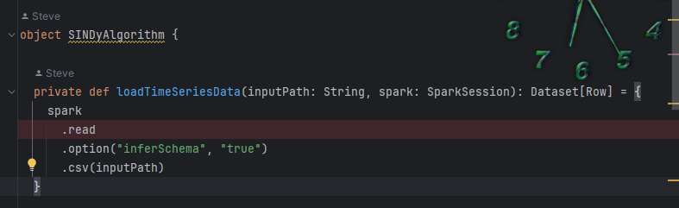
Data Loading:
Introduction to SINDyAlgorithm Scala object.
loadTimeSeriesData method breakdown:
Private method for loading time series data.
Parameters: inputPath (String) and spark (SparkSession).
Returns: Dataset[Row].
Utilizes Spark's read method to read data.
Options set: "inferSchema" set to "true" for schema inference.
Reads data from a CSV file specified by inputPath.
Assumes the CSV file has an inferable schema.
loadTimeSeries Data loads CSV files into Spark DataFrames.

Slide 4
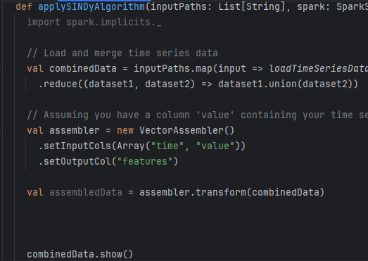
Apply SINDy Algorithm
Public method processes a list of input paths.
Data from multiple paths is merged into a single DataFrame (combinedData).

